Slide 1

Welcome To
Happy Chef

Slide 2
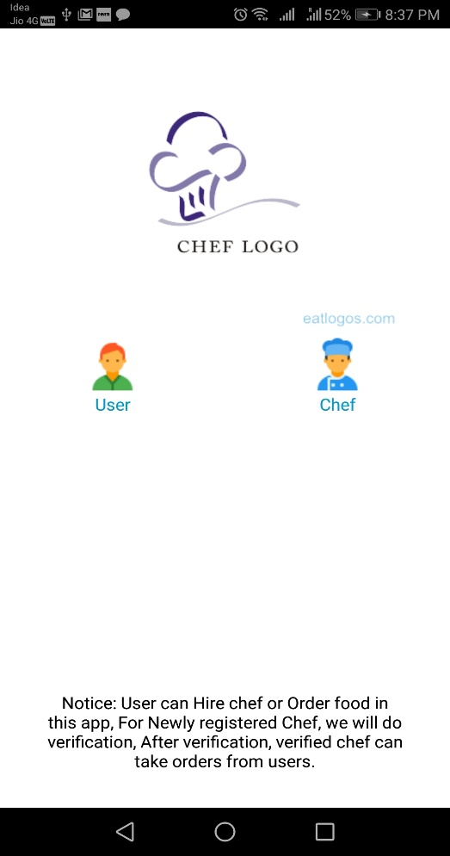

Start Screen
Choose user and chef option before login to app.
In this app user can hire chef and order food.
Any chef can login and take orders from users

Slide 3
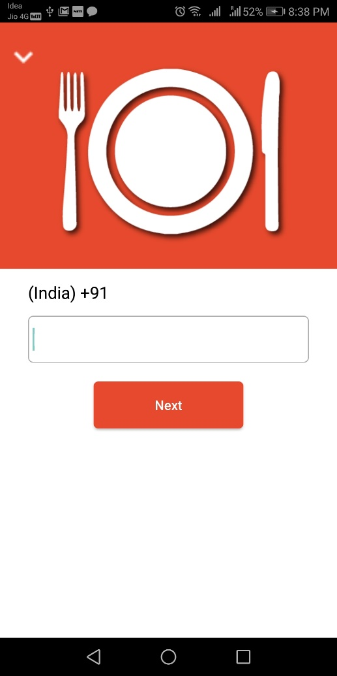

Login Screen
Here User Login: System check old user or new user.
Chef Login: System check old chef or new chef.

Slide 4
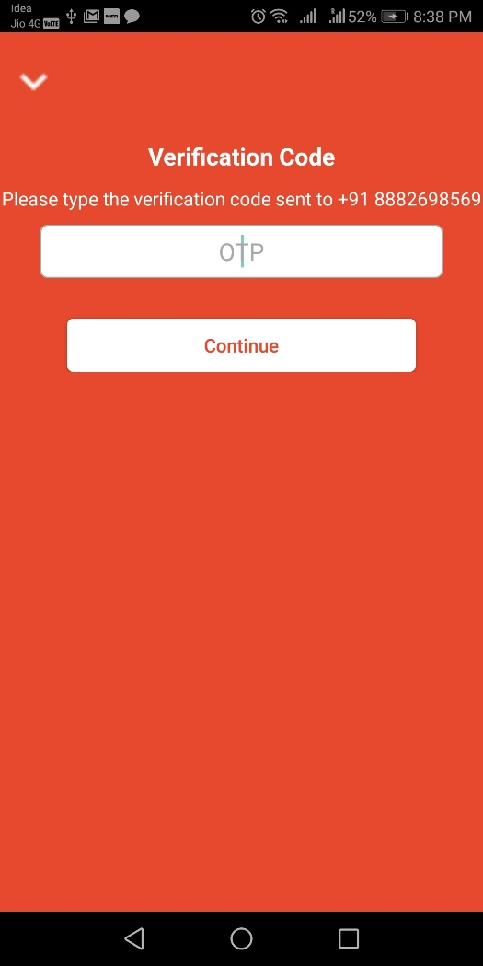
OTP Verification
Here we do
OTP verification

Slide 5
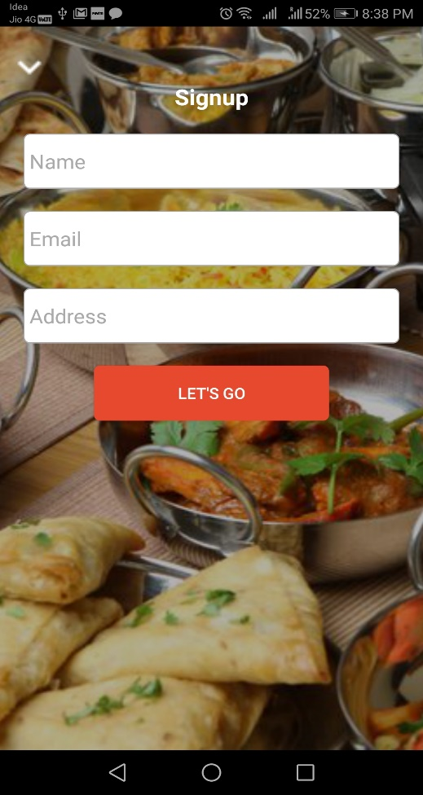
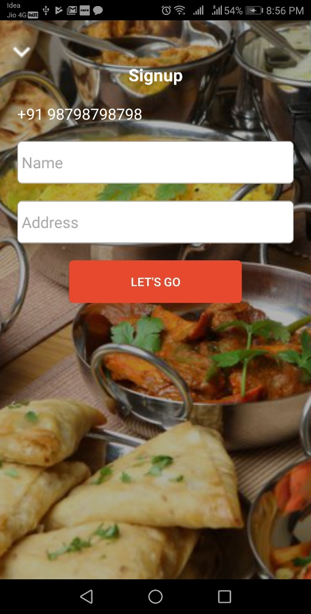
Sign Up Screen
This is User Sign up
Screen
This is Chef Sign up
Screen for new Chef

Slide 6
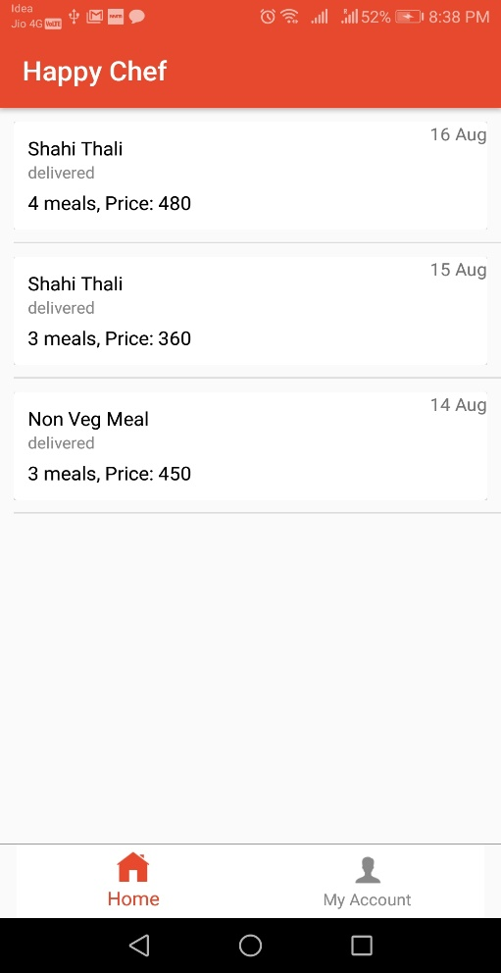
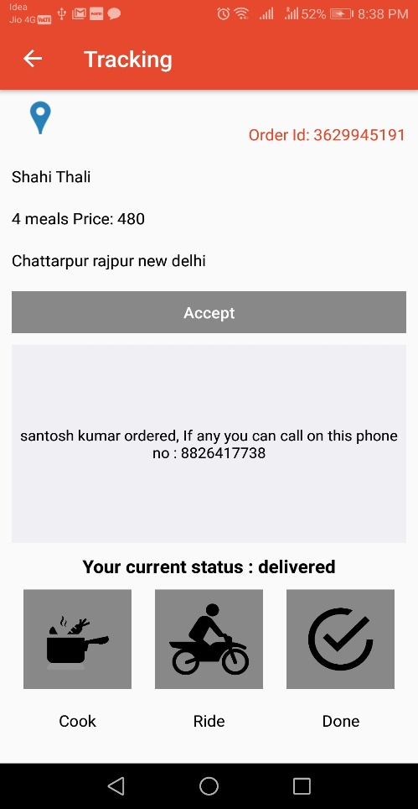
Chef Home Screen
On Click this will open Google map/imap to see user location.
Chef Orders List.
Chef Order Details Screen.
Chef can set his current status.

Slide 7
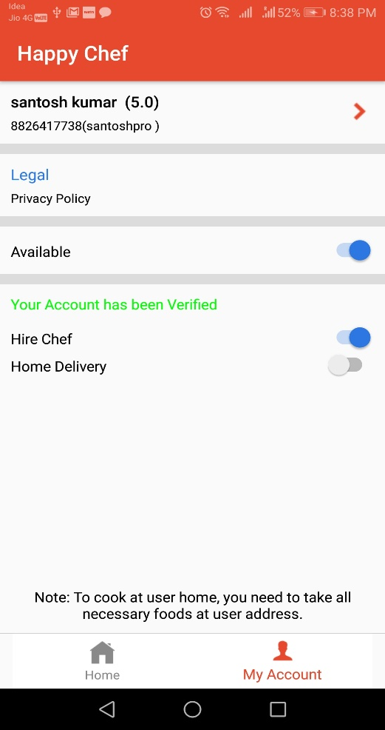
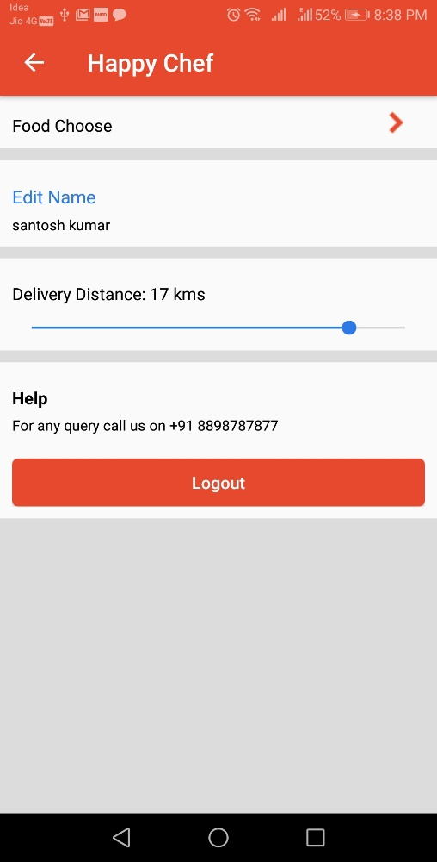
Chef Account Section
Here Chef can set their availability.
Here chef can change name and set distance to deliver/take order
Chef can Choose type.

Slide 8
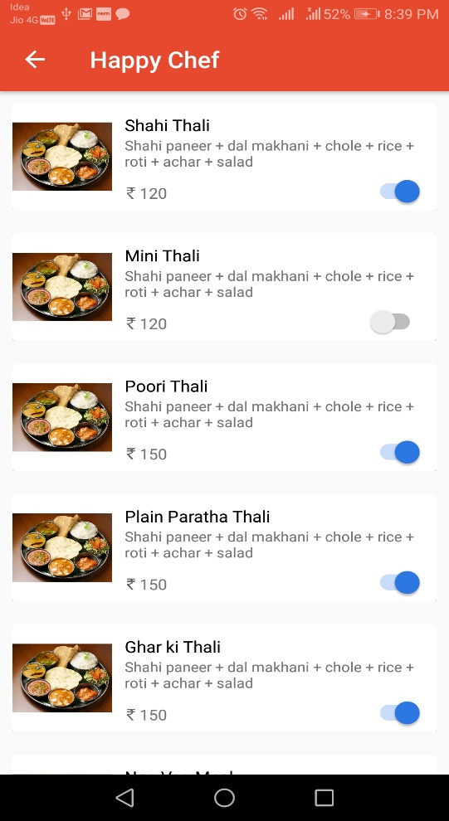
Choose Foods
Here chef can choose foods
To be able to cook in given
price

Slide 9
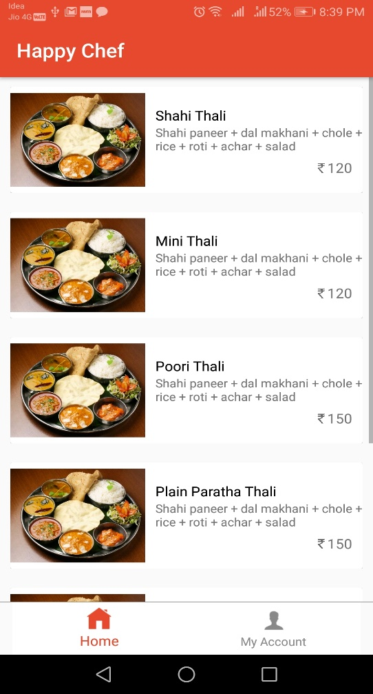
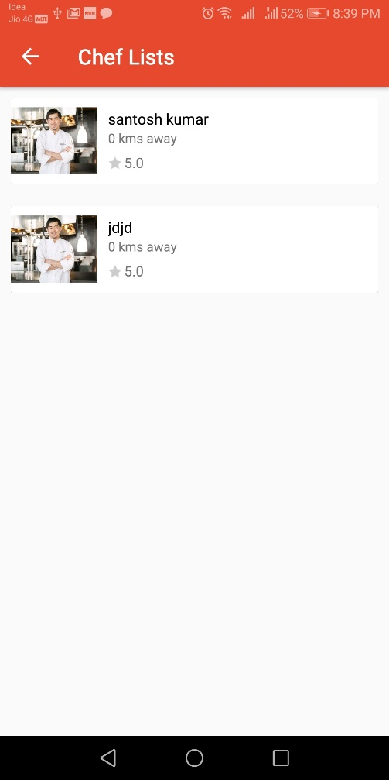
User Home Screen
Here those foods will show
Whose chefs are available
To cook.
On Click food will ask you 2 option hire chef or food order . Then will show available chefs.

Slide 10
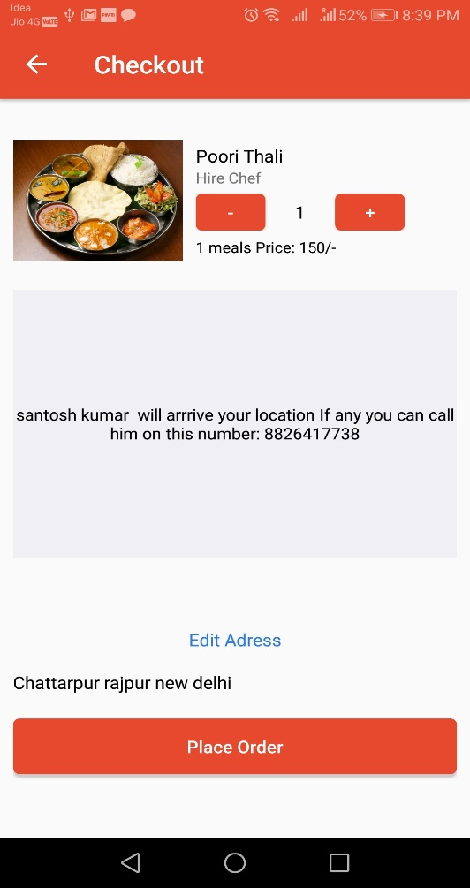
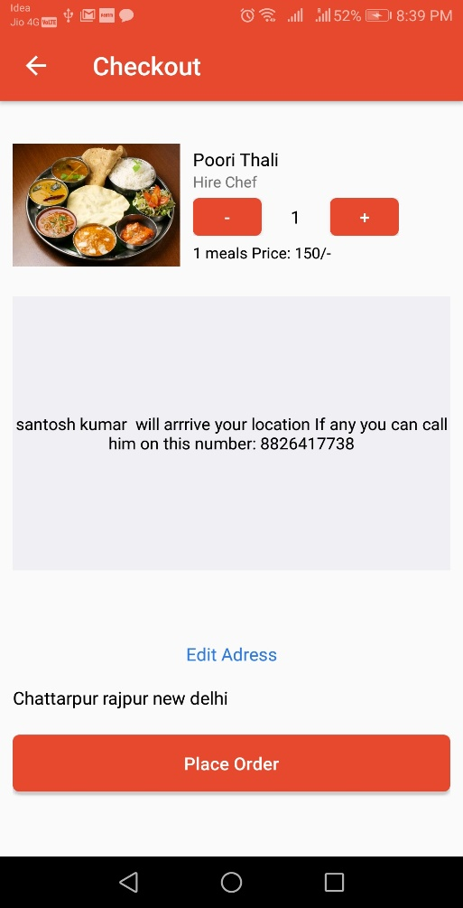
Checkout Screen
In Checkout Screen you can choose no of meals and edit Address.
After Placing your Order. You can track in my Account Section

Slide 11
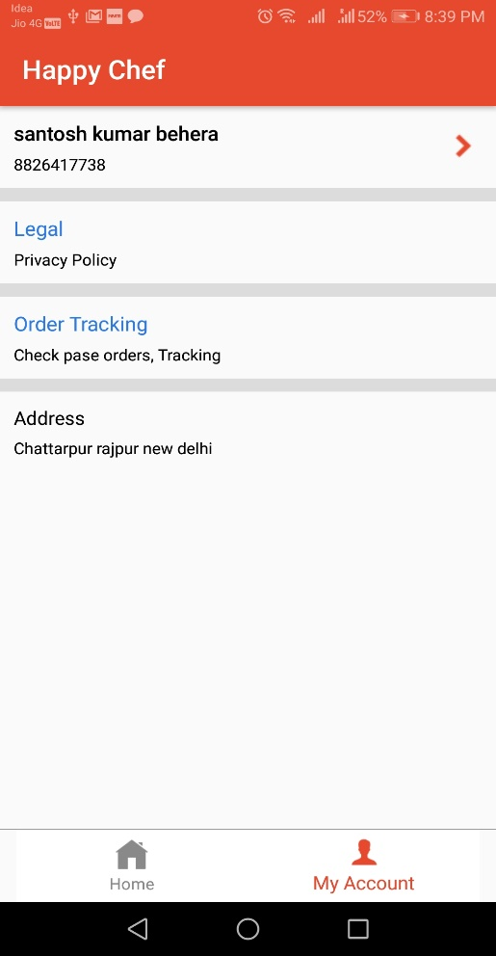
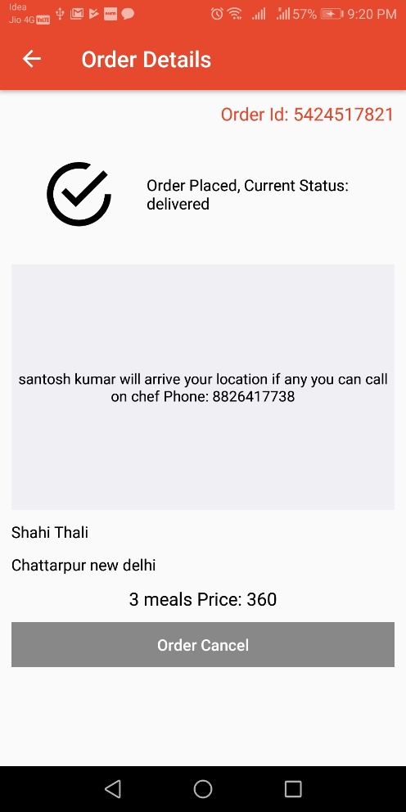
User Account Section
Here User can see their current food status
Here user can track their orders.

Slide 12
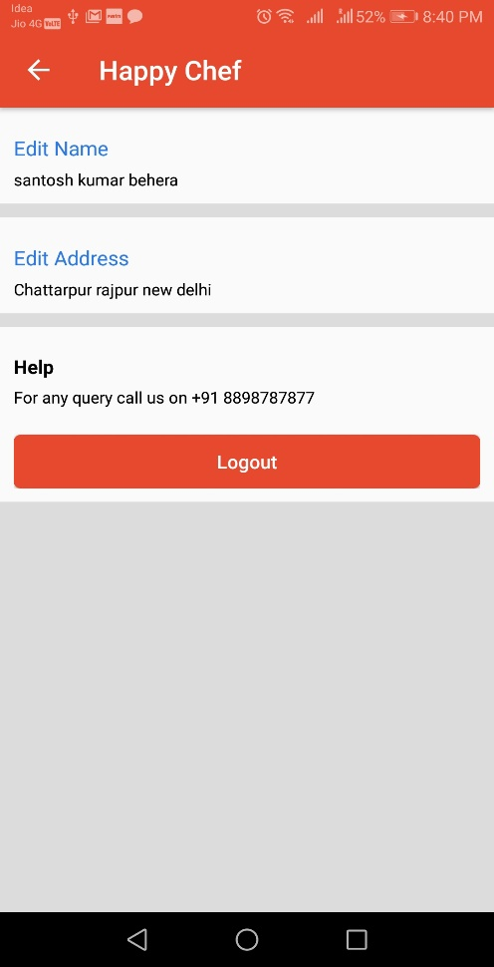
User More Account
User Can Edit their Name and Address

Slide 13
Business Model
Chef Credit System
For New Chef we will provide 10 credits.
By Using credit Chef can take orders.
After accept order credit will be deducted by one.
After finished all credit chef can buy more credits and can take orders from users.
Catering Service
We will provide Big Party Catering Service
We provide monthly basis meal system any organization or School/ College
We Provide Monthly basis meal system to any individual.
We Provide Marriage or any ceremony catering Service.

Slide 14
Thank you

